Slide 1
SSL and HTTPS in Spring Java
Author: Nguyen Vu Long

Slide 2
1. Definition
SSL runs over TCP
SSL (Secure Socket Layer)
HTTPS is HTTP over SSL

Slide 3
Why SSL? SSL Provides ...
Confidentiality (Privacy)
Data integrity (Tamper-proofing)
Server authentication (Proving a server is what it claims it is)
Used in typical B2C transaction
Optional client authentication
Would be required in B2B (or Web services environment in which program talks to program

Slide 4
2. SSL mechanism

Slide 5
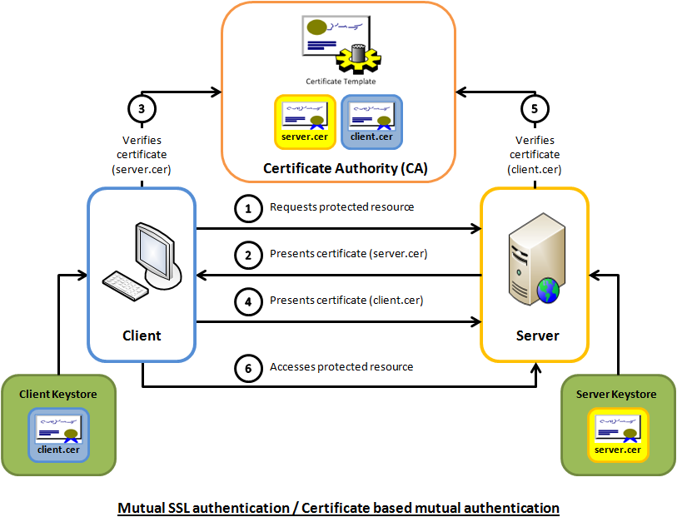

Slide 6
SSL Key Exchange Steps
1. SSL client connects to an SSL server
2. Server then sends its own certificate that contains its public key
3. Client then creates a random key (premaster key) and uses server's public key to encrypt it
4. Client then sends encrypted premaster key to the server
5. Server then decrypts it (only the server that has the matching private key can decrypt it) and uses decrypted premaster key to create secret session key
6. Now both client and server uses secret session key for further communication

Slide 7
Certificates &
Keytool Utility
A certificate is like digital driver license
A certificate is cryptographically signed and is practically impossible for anyone else to forge
A certificate can be purchased from (signed by) a well-known CA (Certificate Authority) like Verisign (for a fee)
A certificate can be self-signed when authentication over the internet is not really a concern, that is only data privacy and integrity are important

Slide 8
3. Example code
https://github.com/longngo1313/https.git

